Slide 1
PDF

Slide 2
PDF Extensions
Adobe’s Portable Document Format (PDF) provides a popular way to get a consistent look, both on screen and when printed, for documents.
PHP has several libraries for generating PDF documents.
The FPDF library is a set of PHP code you include in your scripts with the require function, so it doesn’t require any server-side configuration or support, meaning you can use it even without support from your host.
http://www.fpdf.org/en/download.php can be used to download the fpdf library (v 1.81, ZIP)

Slide 3
FPDF LIBRARY
FPDF is a PHP class which allows to generate PDF files with pure PHP, that is to say without using the PDFlib library.
F from FPDF stands for Free: you may use it for any kind of usage and modify it to suit your needs.
FPDF has other advantages: high level functions. Here is a list :-
Choice of measure unit, page format and margins
Page header and footer management
Automatic page break
Automatic line break and text justification
Image support (JPEG, PNG and GIF)
Colors
Links
TrueType, Type1 and encoding support
Page compression

Slide 4
Creating a Basic PDF
Create a new PHP file and include the FPDF library. Then, create a new instance of the FPDF class:
require 'path/to/fpdf.php';
$pdf = new FPDF();
add a new page to the PDF document:
$pdf->AddPage();
Adds a new page to the document. If a page is already present, the Footer() method is called first to output the footer.
Then the page is added, the current position set to the top-left corner according to the left and top margins, and Header() is called to display the header.
Adding Text to the PDF
To add text to the PDF, use the Cell() method:
$pdf->Cell(0, 10, 'Hello World!', 0, 1)

Slide 5
orientation
Default page orientation. Possible values are (case insensitive):
P or Portrait
L or Landscape
Default value is P.
unit
User unit. Possible values are:
pt: point
mm: millimeter
cm: centimeter
in: inch
A point equals 1/72 of inch, that is to say about 0.35 mm (an inch being 2.54 cm).
This is a very common unit in typography; font sizes are expressed in that unit. Default value is mm.
size
The size used for pages. It can be either one of the following values (case insensitive):
A3
A4
A5
Letter
Legal
or an array containing the width and the height (expressed in the unit given by unit). Default value is A4.
$pdf = new FPDF('P', 'mm', array(100,150));

Slide 6
Ln
Ln([float h])
Description
Performs a line break. The current abscissa goes back to the left margin and the ordinate increases by the amount passed in parameter.

Slide 7
The Cell() method takes the following parameters:
Width: Width of the cell
Height: Height of the cell
Text: The content of the cell
Border: Border type (0 for no border, 1 for a full border)
Next line: Where the cursor should move after the cell (0 for right, 1 for a new line)
Styling Text
You can style the text using the SetFont() method. The first parameter sets the font family, the second parameter sets the font style, and the third parameter sets the font size:
$pdf->SetFont('Arial', 'B', 14);

Slide 8
Adding Images to the PDF
To add an image to the PDF, use the Image() method:
$pdf->Image('path/to/image.jpg', 10, 30, 50, 50);
The Image() method takes the following parameters:
File: Path to the image file
X: X-coordinate of the upper-left corner of the image
Y: Y-coordinate of the upper-left corner of the image
Width: Width of the image
Height: Height of the image

Slide 9
Generating and Saving the PDF
Finally, generate the PDF and save it to a file or output it to the browser:
// Save the PDF to a file
$pdf->Output('F', 'filename.pdf');
// Output the PDF to the browser
$pdf->Output('I’);
I: send the file inline to the browser. The PDF viewer is used if available.
D: send to the browser and force a file download with the name given by name.
F: save to a local file with the name given by name (may include a path).
S: return the document as a string.
The default value is I.

Slide 10
DOCUMENTS AND PAGES
<?php
require('fpdf.php');
$pdf = new FPDF();
$pdf->AddPage();
$pdf->SetFont('Times', 'B', 20);
$pdf->Cell(176, 5, 'Welcome to PHP', 0, 0, 'C');
$pdf->Ln();
$pdf->SetFont('Times', 'B', 12);
$pdf->Cell(176, 10, 'A Computer Science', 0, 0, 'C');
$pdf->Output();
?>

Slide 11
Cell(float w , float h , string txt , mixed border , int ln , string align , boolean fill , mixed link)
W = Cell width. If 0, the cell extends up to the right margin. .
H = Cell height. Default value: 0.
Txt = String to print. Default value empty
Border = (1,0), (L,T,R,B)
In = 0 to the right, 1 beginning of next line, 2 below
Align = L,R,C
Fill = cell background to be painted true or false
Mixed = url returned by addlink()
$pdf->Cell(20, 10, 'Title', 1, 1, 'C');

Slide 12
Text
There are many options for changing the appearance and layout of text.
Coordinates
The origin (0,0) in a PDF document with the FPDF library is in the top-left corner of the defined page.
All of the measurements are specified in points, millimeters, inches, or centimeters. A point (the default) is equal to 1/72 of an inch, or 0.35 mm
Text attributes
There are three common ways to alter the appearance of text: bold, underline, and italics.
Setfont(string family , string style , float size);
Family = Courier (fixed width), Helvetica or Arial (Sans Serif), Times (Serif), Symbol (Symbolic), Zapfdingbats (Symbolic)
Style = empty, B, I, U
Size = font size in point.

Slide 13
Addfont(string family , string style , string file)
Family = font family name.
Style = empty, B, I, U
File = The font definition file.
Settextcolor(int r , int g, int b)
r = red component (0 – 255)
g = green component (0 – 255)
b = blue component (0 – 255)

Slide 14
IMAGE AND LINKS
The FPDF library can also handle image insertion and control links within the PDF document or externally to outside web addresses.
We have to specify an image file to use and to call the image() method to place the image on the PDF document.
image(file , float x , float y , float w , float h , string type , mixed link)
File = Path or URL of the image.
Float x = coordinate of the upper-left corner.
Float y= coordinate of the upper-left corner.
Float w= Width of the image in the page.
Float h= Height of the image in the page.
Type= Image format JPG, JPEG, PNG and GIF.
Link = URL or identifier returned by AddLink().

Slide 15
FPDF can create two kinds of links.
One kind is to have a link within the PDF document to another location within the same document (two pages later, or wherever you set the anchor for the link); this is called an internal link.
The other kind is an external web URL link.
An internal link is created in two parts. First you define the starting point or origin for the link, and then you set the anchor, or destination, for where the link will take you when it is clicked.
To set a link’s origin, use the addLink() method. Return a handle that you need to use when creating the destination portion of the link.
We create the destination portion of the link with the setLink() method, which takes the origin’s link handle as its parameter, so that it can perform the join between the two steps.

Slide 16
External URL type link, can be done in two ways.
If you are using an image as a link, you will need to use the image() method.
If you want straight text to be used as a link, you need to use the cell() or write() method.

Slide 17
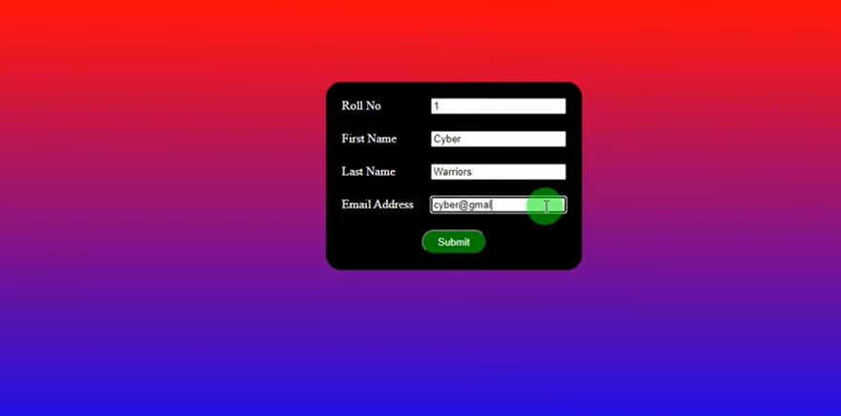
creating pdf documents in php

Slide 18
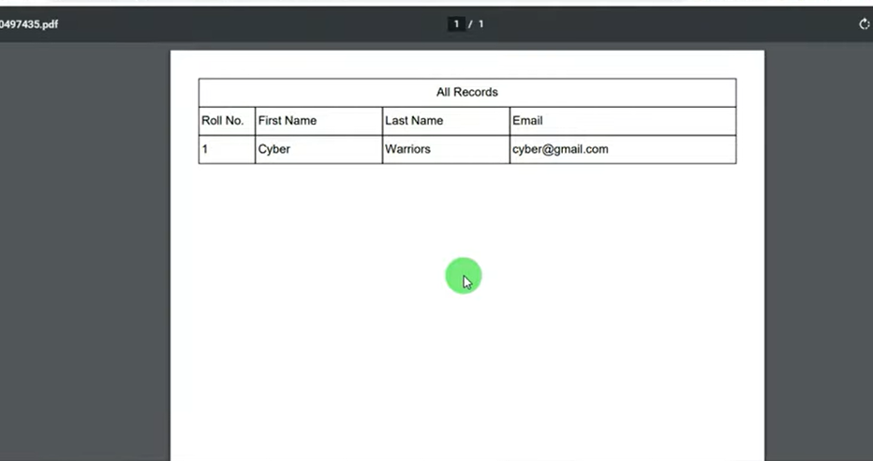
creating pdf documents in php

Slide 19

creating pdf documents in php

Slide 20
<?php
if(!empty($_POST['submit']))
{
$roll= $_POST['rollno'];
$F_name= $_POST['firstname];
$l_name= $_POST['lastname'];$
$email= $_POST['email'];
require("fpdf.php");
$pdf = new FPDF();
$pdf->Addpage();
$pdf=SetFont("arial","",16);
$pdf->Cell(0,10,"Registartion Details",1,1,'C');
$pdf->Cell(20,10,"Roll No.",1,0);
$pdf->Cell(45,10,"first Name",1,0);
$pdf->Cell(45,10,"Last name",1,0);
$pdf->Cell(0,10,"Email",1,0);
$pdf->Cell(20,10,$roll,1,0);
$pdf->Cell(45,10,$fname,1,0);
$pdf->Cell(45,10,$lname,1,0);
$pdf->Cell(0,10,$email,1,0);
$pdf->output();
?>

